Slide 1
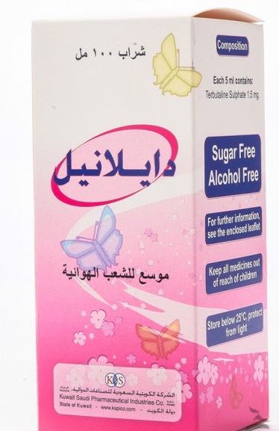
Delanil syrup 100 ml
6.25 R.S
- Dailanil as a bronchodilator and makes breathing easier in people with breathing problems including :- Asthma;- Chronic obstructive pulmonary disease (COPD)

Slide 2
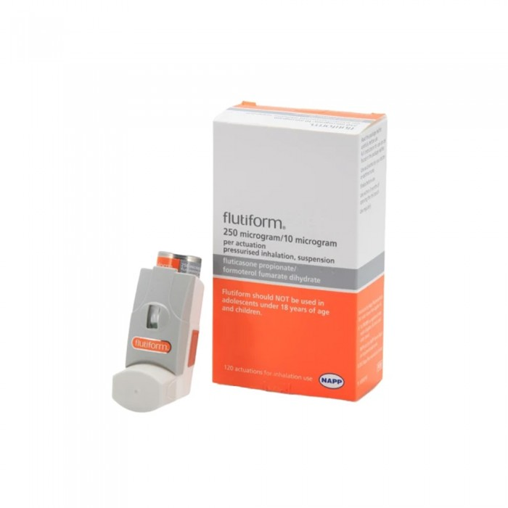
Flutiform 250/10 micrograms inhalation 120 doses
225.00 R.S
Flutiform -U – IHU is used in treatment, control and Prevention and is used to reduce inflammation in the lungs and keep the airways open. It contains fluticasone belongs to a group of drugs called steroids, which are drugs used to reduce inflammation by narrowing blood vessels and preventing the release of substances that cause inflammation .

Slide 3
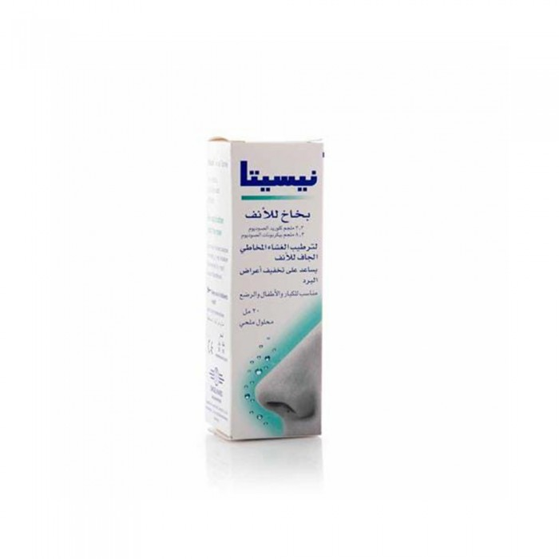
Nicita nasal spray-for cold symptoms 20 ml
40.25 R.S
Method of use:- For adults and children aged two years and above: - 1 or 2 sprays per nostril from 4 to 6 times a day- For children under two years of age: - one spray per nostril 3 times a day

Slide 4
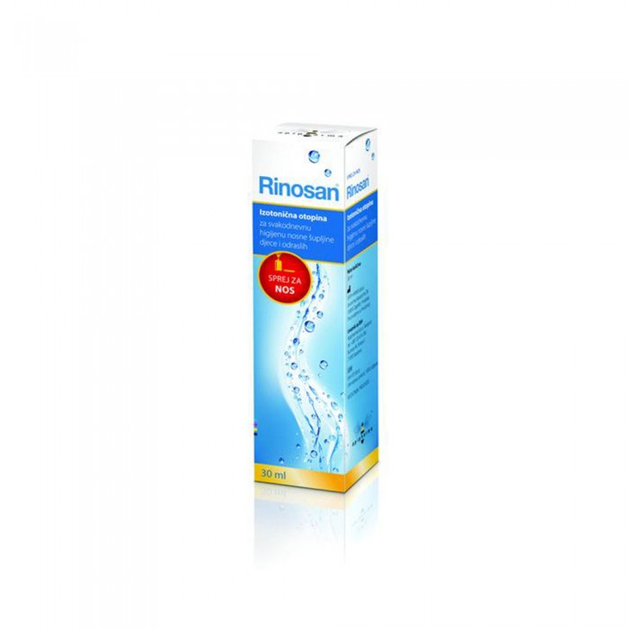
Rhinosan nasal spray for cold symptoms 30 ml
47.75 R.S
Spray nasal spray into both nostrils as required. One spray in each nostril is suitable for moisturizing the dry mucous membrane.

